Slide 1
Tableau Workshop
By Moksha Poladi & Jessica Guzman

Slide 2
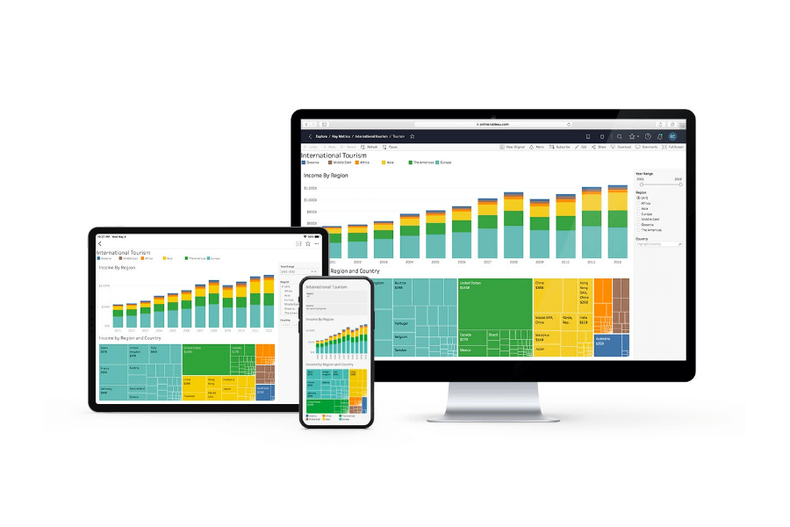
Tableau
What is it?
Business intelligence & data visualization tool
Easily inputs data to make quick, understandable graphs
Industry-focused
Data analytics for non-analysts
Dashboards for project/cycle reporting

Slide 3
How to access Tableau
You can work on Tableau online for free! The link to the website is: https://www.tableau.com/trial/tableau-online
Here you can sign up and access Tableau online
Alternatively, you can download Tableau desktop and work locally. Here is the link to do that:https://www.tableau.com/academic/students
As students of UCSD, you can get a one-year free license! Just sign up at the link above, enter your details, download Tableau desktop and get started!

Slide 4
Tableau Challenge!
We want to help you guys get started with working with fun and interesting Tableau visualizations. So we have decided to host the Tableau Challenge!
Work in pairs (or individually) on a dataset of your choice and create exciting visualizations using Tableau! (While we encourage you to choose a dataset that interests you, feel free to use the dataset we worked with during the workshop linked in our github repo below).
Create a minimum of three sheets and a dashboard.
Submit either your workbooks or a pdf of your dashboard to dds@ucsd.edu
Take a look at our GitHub repository containing these slides, the datasets and our workbooks used during the presentation: https://github.com/M2606/DDS_Tableau_Workshop.git
The top three visualizations get exciting prizes so be creative and most importantly, have fun!
Last day to submit: 05/25/2021. Winners will be announced at our GBM the next day! (05/26/2021).

Slide 5
GBM 2!!
Our GBM 2 will be on 05/26/2021 at 8PM! We hope to see you all there!
Get a chance to meet some of our new board members!
The Tableau Challenge winners will be announced
Our first ever DDS Project Team will be presenting their amazing project that they have been working on this quarter!

